Slide 1
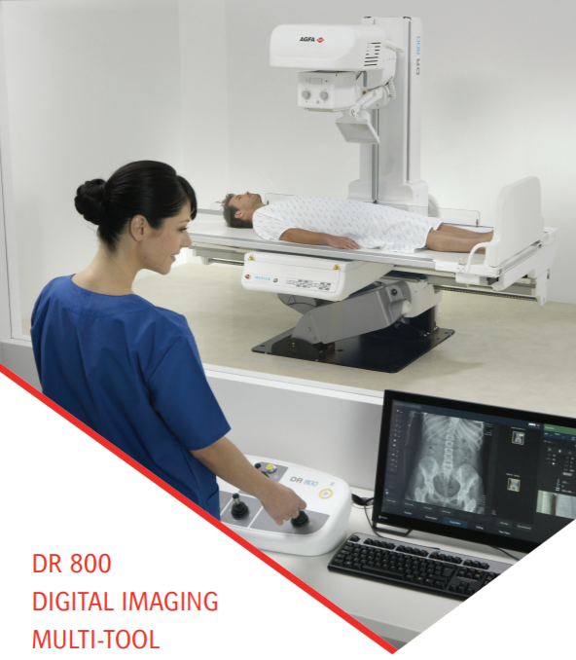
DR 800
DIGITAL IMAGING MULTI-TOOL

Slide 2
DR Room general concerns
Versatility of the DR Room
Financial value
Image quality
Room efficiency
Patient satisfaction
Operator comfort

Slide 3
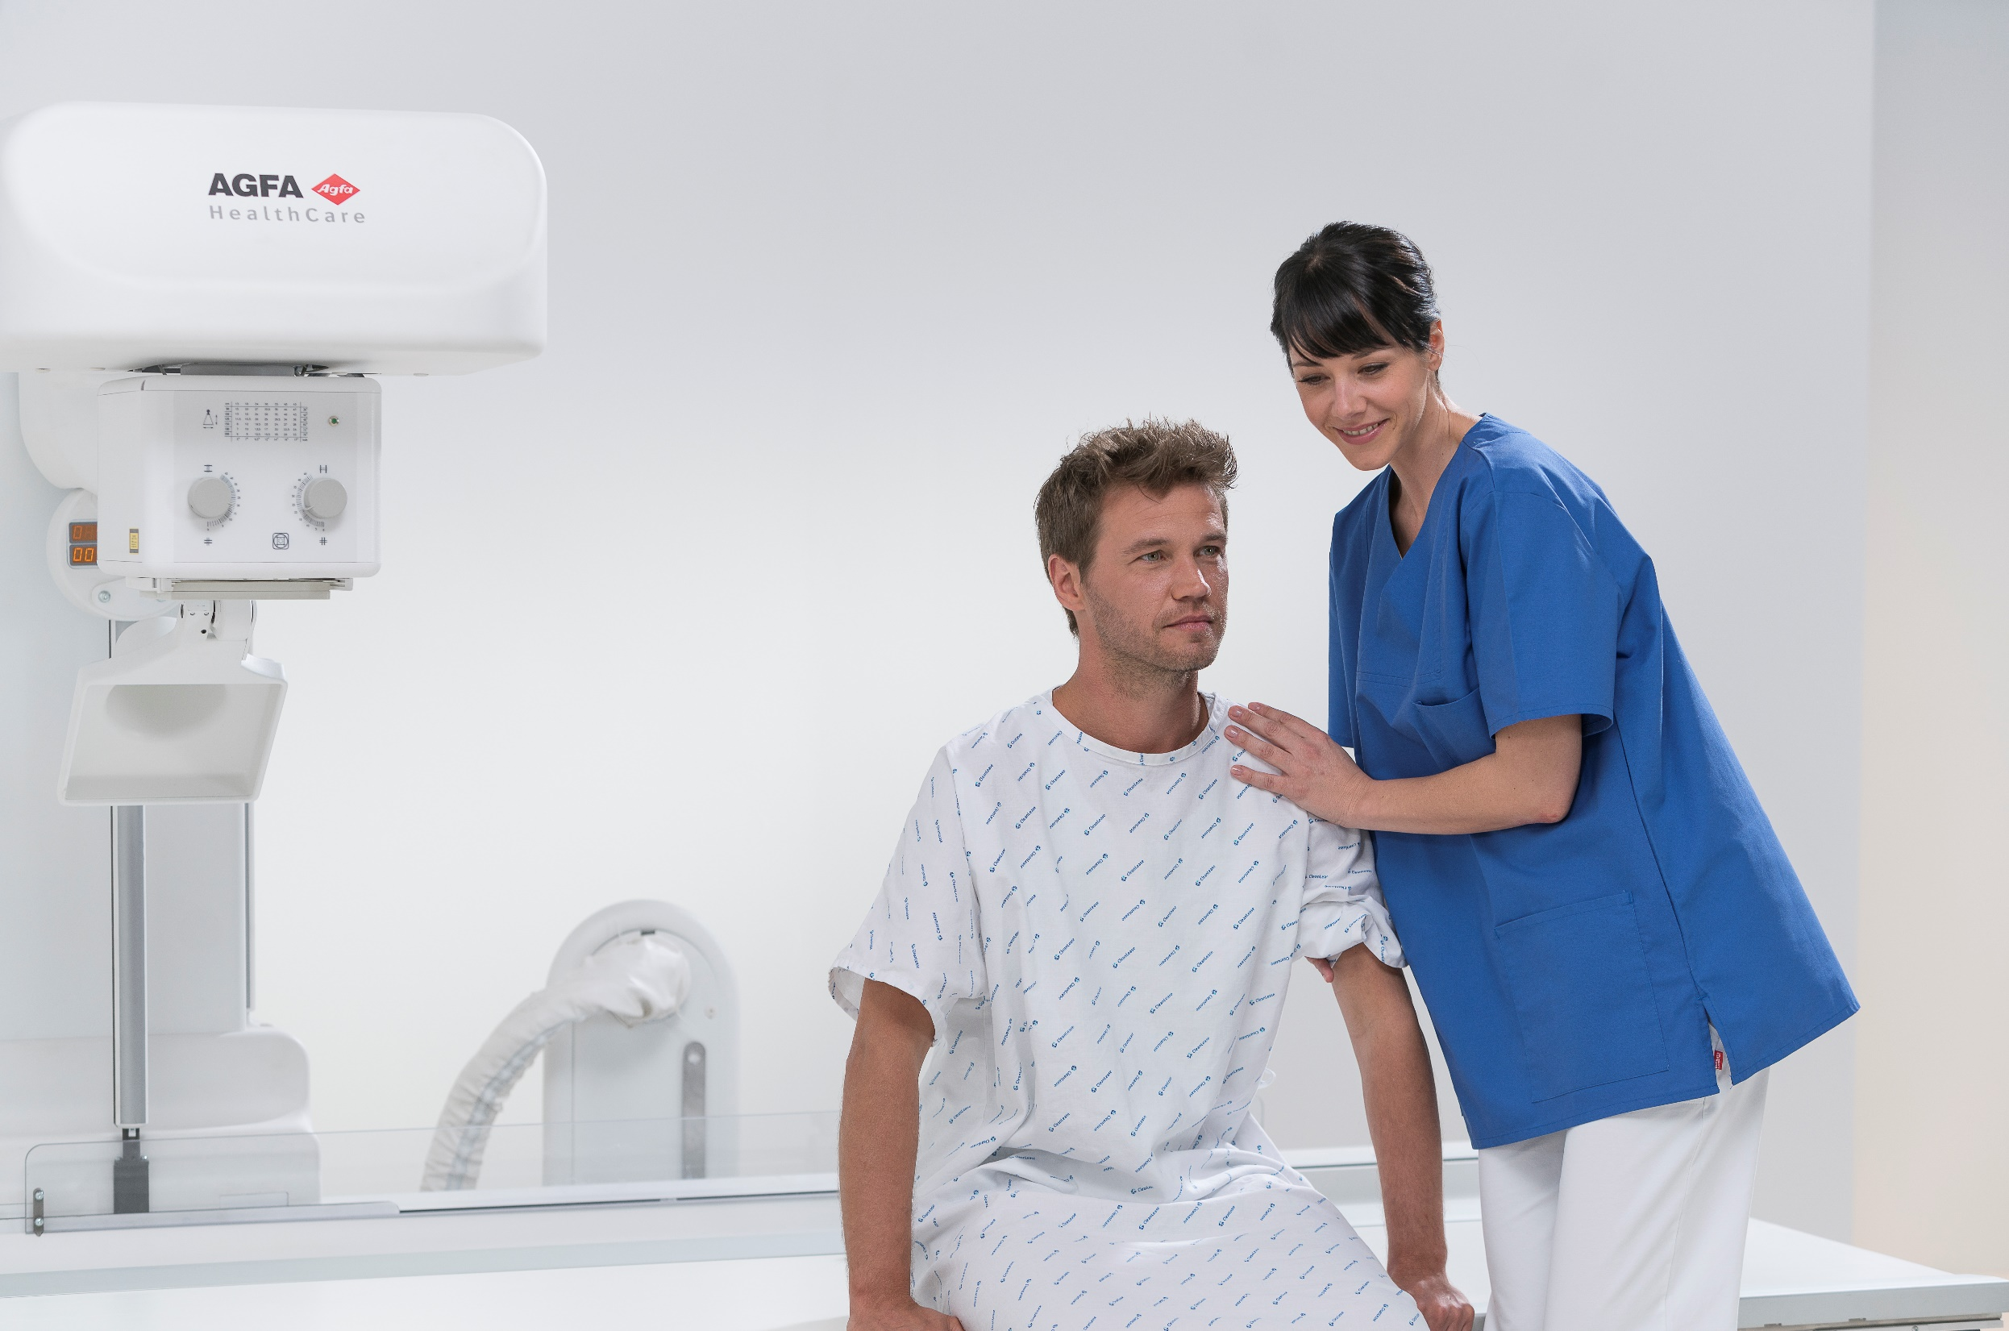
DR 800
Digital Imaging Multi-tool
Customer driven design
Multi-purpose DR solution
Dynamic MUSICA
Workflow focused design
Patient Care
Financial value (TCO)

Slide 4
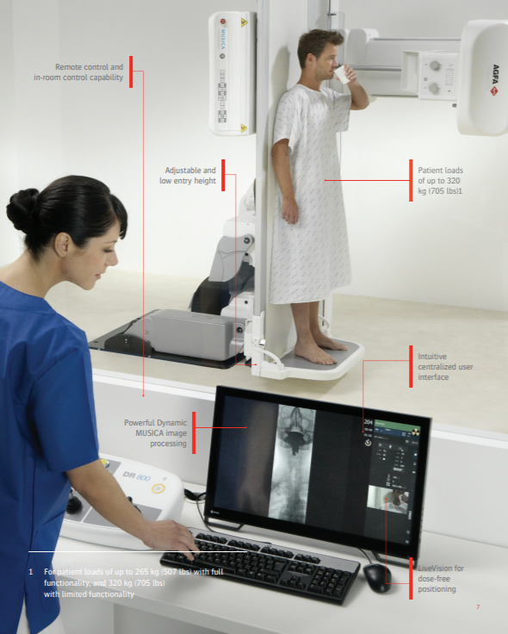
Customer driven design
The DR 800 was designed in co-operation with leading healthcare providers, to meet the demanding clinical requirements for optimal operator convenience and the best patient care

Slide 5
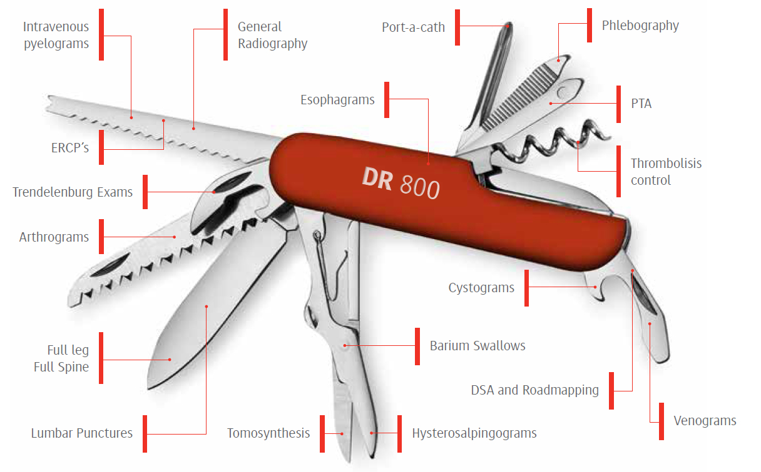
Multi-purpose DR solution - from basic to advanced applications
Flat panel detector system combining:
Radioscopy
Fluoroscopy: up to 30 frames per second acquisition rate
Advanced Clinical Applications:
Digital tomosynthesis: drives high-resolution, limited-angle tomography with very fast, multi-slice image reconstruction.
Digital Subtraction Angiography (DSA) : real-time subtraction after injection of contrast agent

Slide 6
Multi-purpose solution - from basic to advanced applications
Roadmapping: Visualization technique used during interventional exams: facilitates maneuvering through the vasculature to position catheters, stents, introduce a balloon to dilate a stenosis,…
Easystitch: standard Full leg / full spine capabilities, including tube and detector positioning, for acquisition of up to four images. Extensive orthopedic tools can be added.
Extremities: Motorized tube column angulation, manual tube rotation, enables end-to-end table-top coverage and unrestricted examination of extremities.

Slide 7
Multi-purpose solution - from basic to advanced applications
Pediatric imaging: On-board MUSICA, pulsed fluoroscopy, high power generator (resulting in short exposure times). Automated extra filtration and antiscatter grids enable you to minimize the patient dose.
Standing: Tube and table rotation features enable off-table weight bearing studies and other challenging exams.
Chest: The 180 cm Source Image Distance (SID) allows chest imaging at the standard SID without additional equipment.

Slide 8
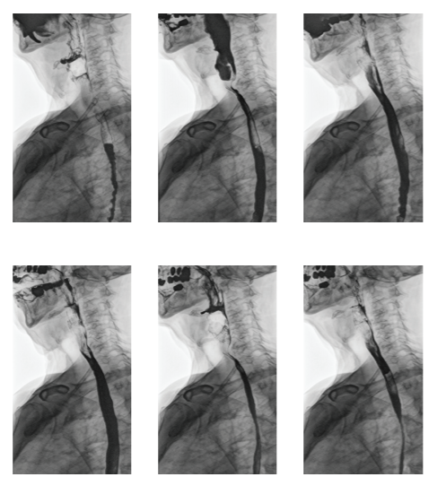
Dynamic MUSICA
Revolutionary, high speed, multi-scale image processing
Superb image quality
Lowest possible dose
Enhance noise suppression
Superb brightness
Density stabilization
Smooth, efficient workflow

Slide 9
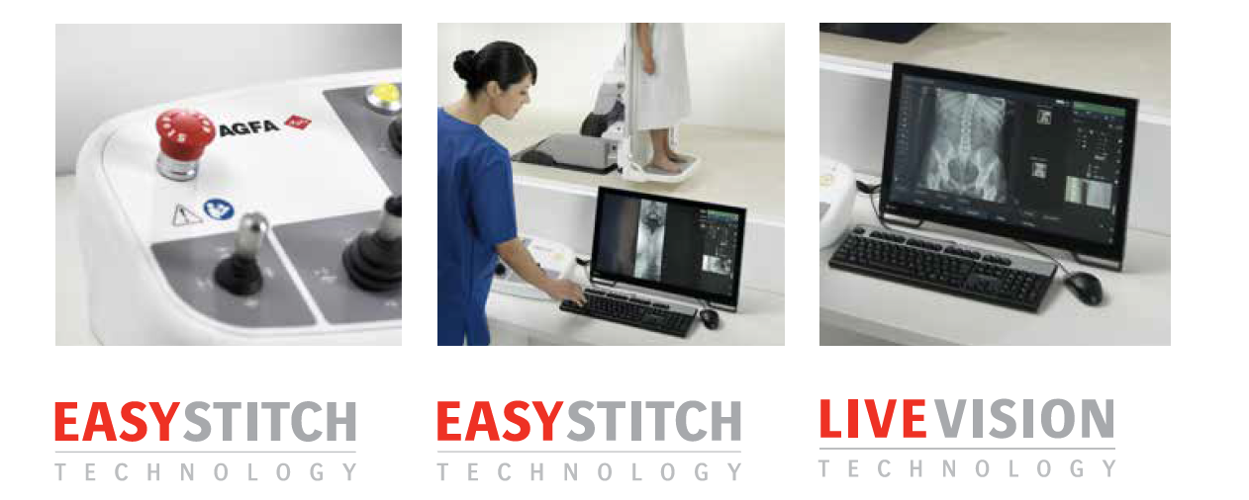
Workflow focused design
VarioDrive movements for both manual and auto-positioning contribute to a quick, easy procedure for the patient.
Seamless automatic stitching directly on the table allowing simple, precise horizontal and vertical Full Leg Full Spine (FLFS) procedures
LiveVision: First-person camera view of your patient, allowing you to remote position patients to keep an eye on them without radiation.

Slide 10
Workflow focused design
SmartRotate brings Artificial intelligence to your digital equipment at the point of care. Every image is presented ready for viewing, directly and automatically.
RaySense: integrate auto-switching anti-scatter grid ( optional)

Slide 11
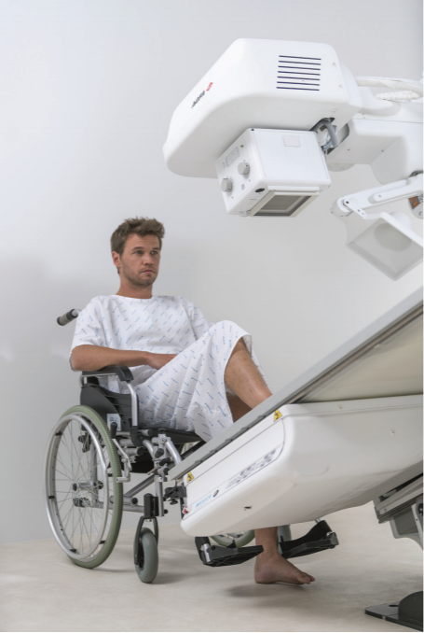
Patient Care
Patient-side & remote controlled R&F
Robust weight capabilities, for patient loads of up to 265 kg (507 lbs) with full functionality, and 320 kg (705 lbs) with limited functionality.
Simplified access, even for patients with limited mobility thanks to the smooth motorized table and low height adjustment capability.
Effortless patient transfer from stretcher or bed, with clear access to a 120-cm section of the table.
Maximum operator and patient comfort, with fast, robust and smooth table movements. The table can be titled +90%/-90% for standing exams, optimal positioning, and more.

Slide 12
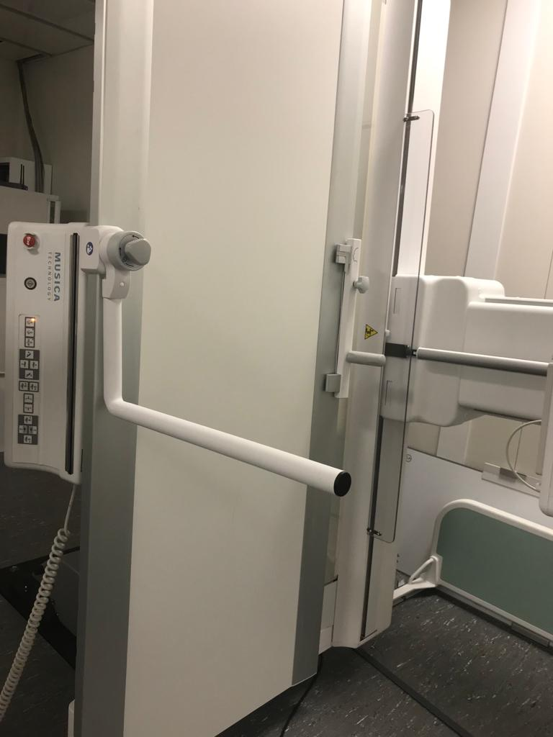
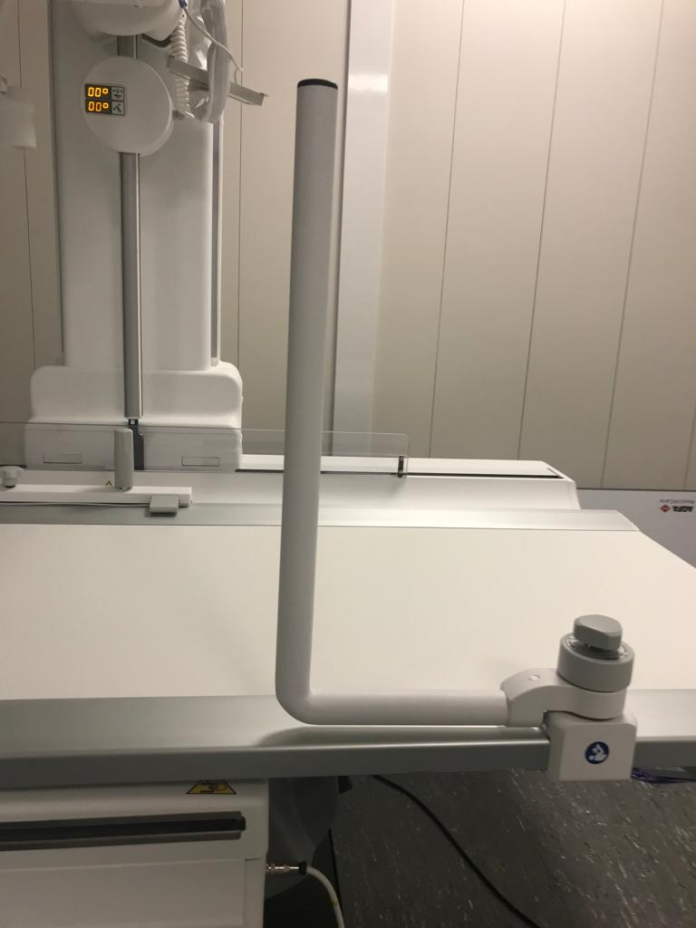
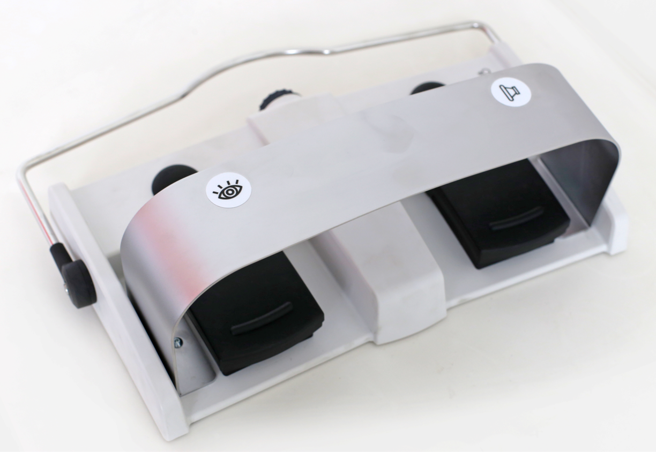
Patient Care
For patient care, use in-room, table side controls or the wireless in-room remote console, together with the in room MUSICA station giving you full control of all parameters
Lateral arm rest for the table, more comfortable and better positioning of patients during lateral expostions, gives patient confidence while being lifted on the footrest.
Wireless foot pedal, more flexibility allowing the positioning at any place during procedures

Slide 13
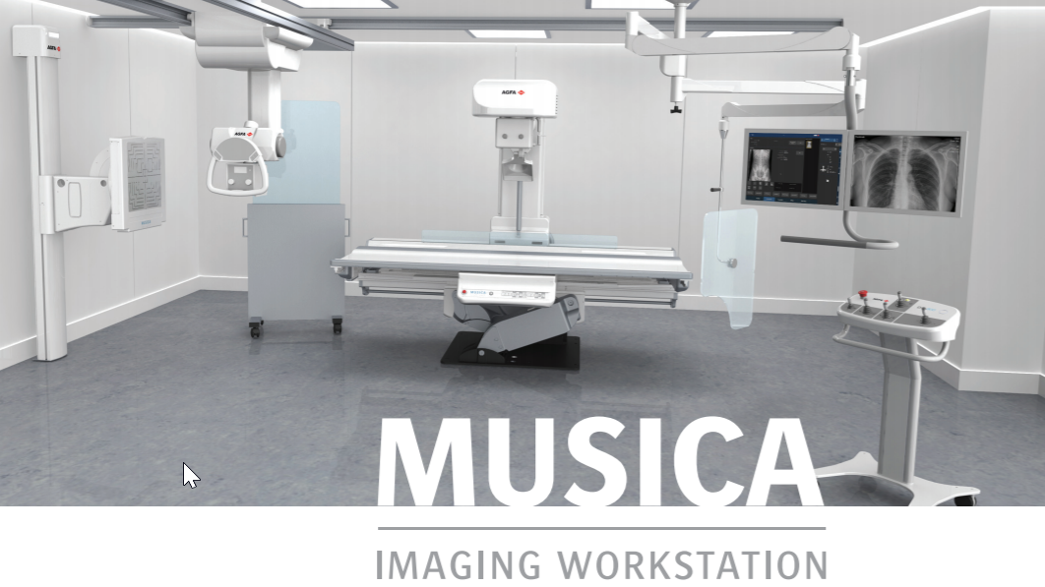
Make Dose matter….
Integrated Dose Area Product (DAP) meter, allowing the automatic reporting of dose;
Cesium Iodide (CsI) detectors, for optimal image quality with a lower radiation dose;
MUSICA image processing, getting you more from your images, automatically at acquisition with exquisite detail at a lower dose;
LiveVision, enabling accurate radiation dose-free remote positioning.

Slide 14
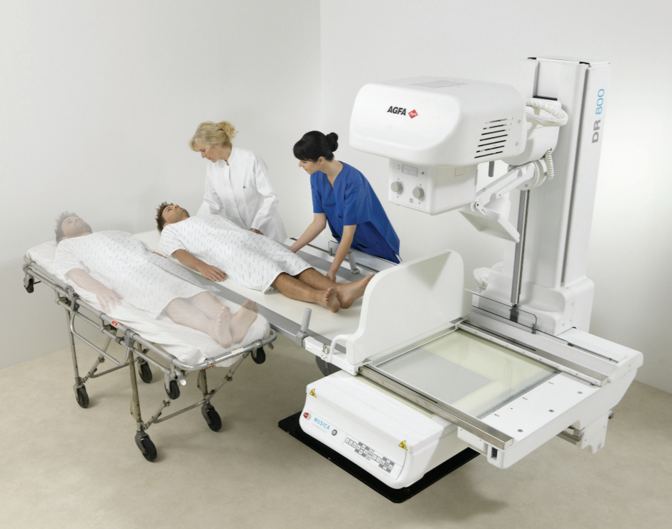
Optimized financial value
One investment for a broad range of applications encompasses all types of exams, so you don’t need additional specialty rooms.
We offer service agreement solutions tailored to your situation, making your lifecycle costs predicable.

Slide 15
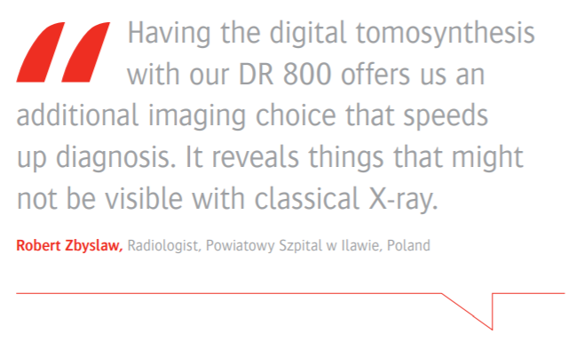
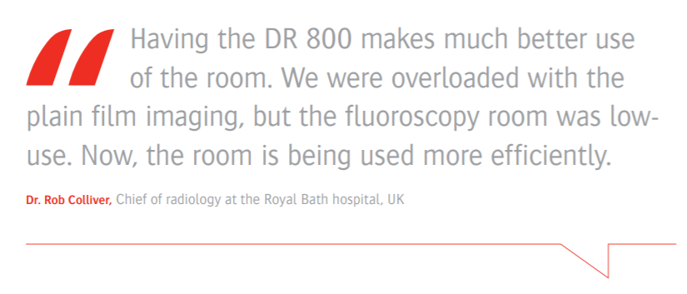
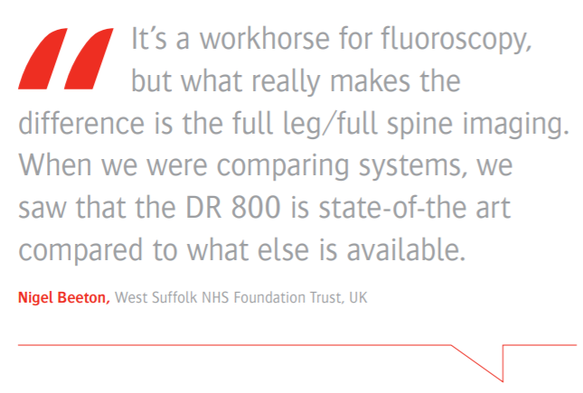
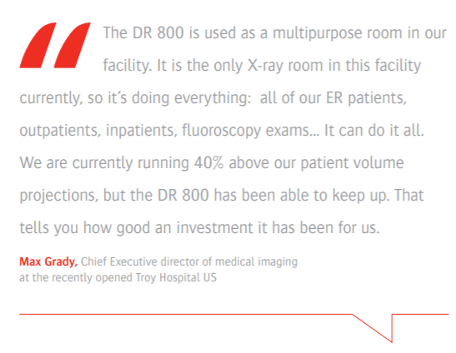
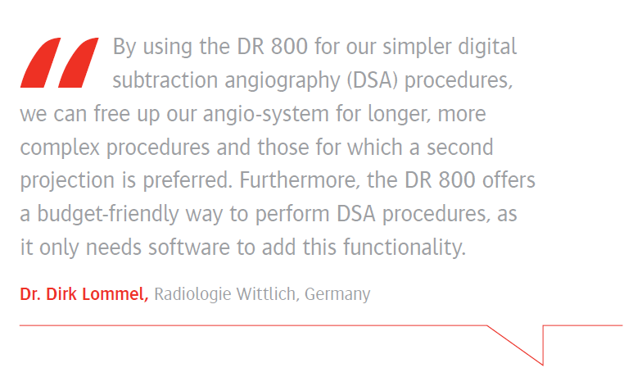
What our customers say…

Slide 16
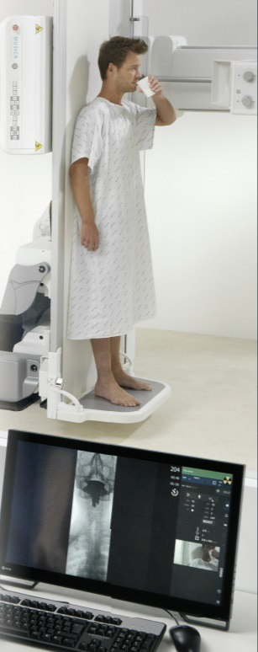
DR Room: the concerns & Agfa’s answers
Versatily of the room
Multi-purpose system
General Radiography
Fluoroscopy
Digtal Substraction Angiography
Digital Tomosynthesis
Roadmapping
Full leg/Full Spine
Peadiatric
Financial value
One investment for a broad range of applications.
No need for additional specialty rooms.
Tailor-made service agreement solutions, making your lifecycle costs predicable.
Image quality
Dynamic MUSICA
Superb image quality
Lowest possible dose
For Genrad & Fluoroscopy
Enhance noise suppression
Superb brightness
Density stabilization
Smooth, efficient workflow
Room efficiency
VarioDrive
For both manual and auto-positioning
Easystitch
Seamless automatic stitching
LiveVision
First-person camera view of your patient
Patient satisfaction
Robust weight capabilities
Simplified access
Operator comfort
Effortless patient transfer from stretcher or bed
clear access to a 120-cm section of the table.
fast, robust and smooth table movements.
The table can be titled +90%/-90%
table side controls
wireless in-room remote console

Slide 17
DR 800
Digital Imaging Multi-tool

