Slide 1
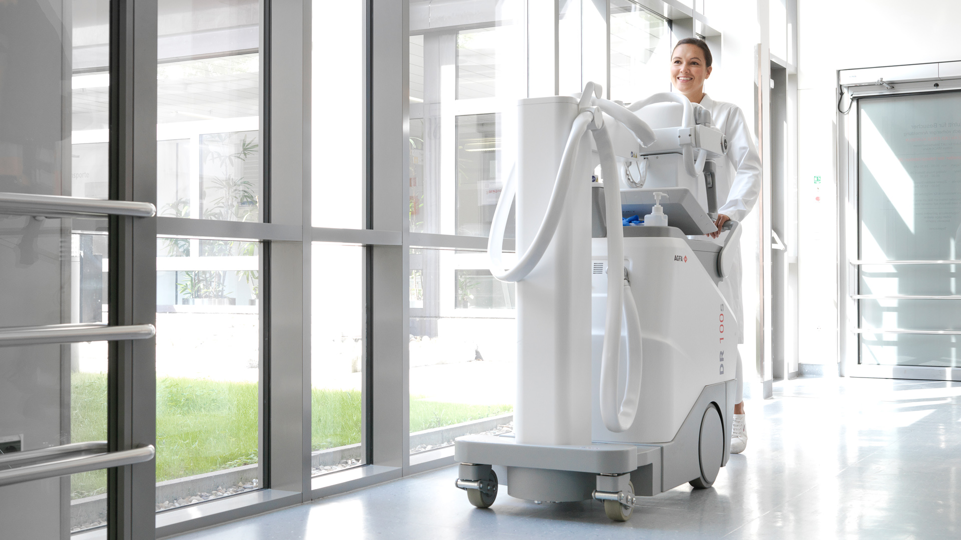
DR 100s
A new Force in mobile imaging

Slide 2
Mobile DR concerns
Patient and staff safety
Maneuverability of mobile unit
Maneuverability of tube head at bedside
Detector protection
X-ray alignement at bedside
System ergonomics
Limited applications with mobile unit

Slide 3
DR 100s
A new Force in mobile imaging
Customer Driven Design
MUSICA intelligence
First time right imaging
Streamlined workflow
Enhanced productivity
Excellent ergonomics

Slide 4
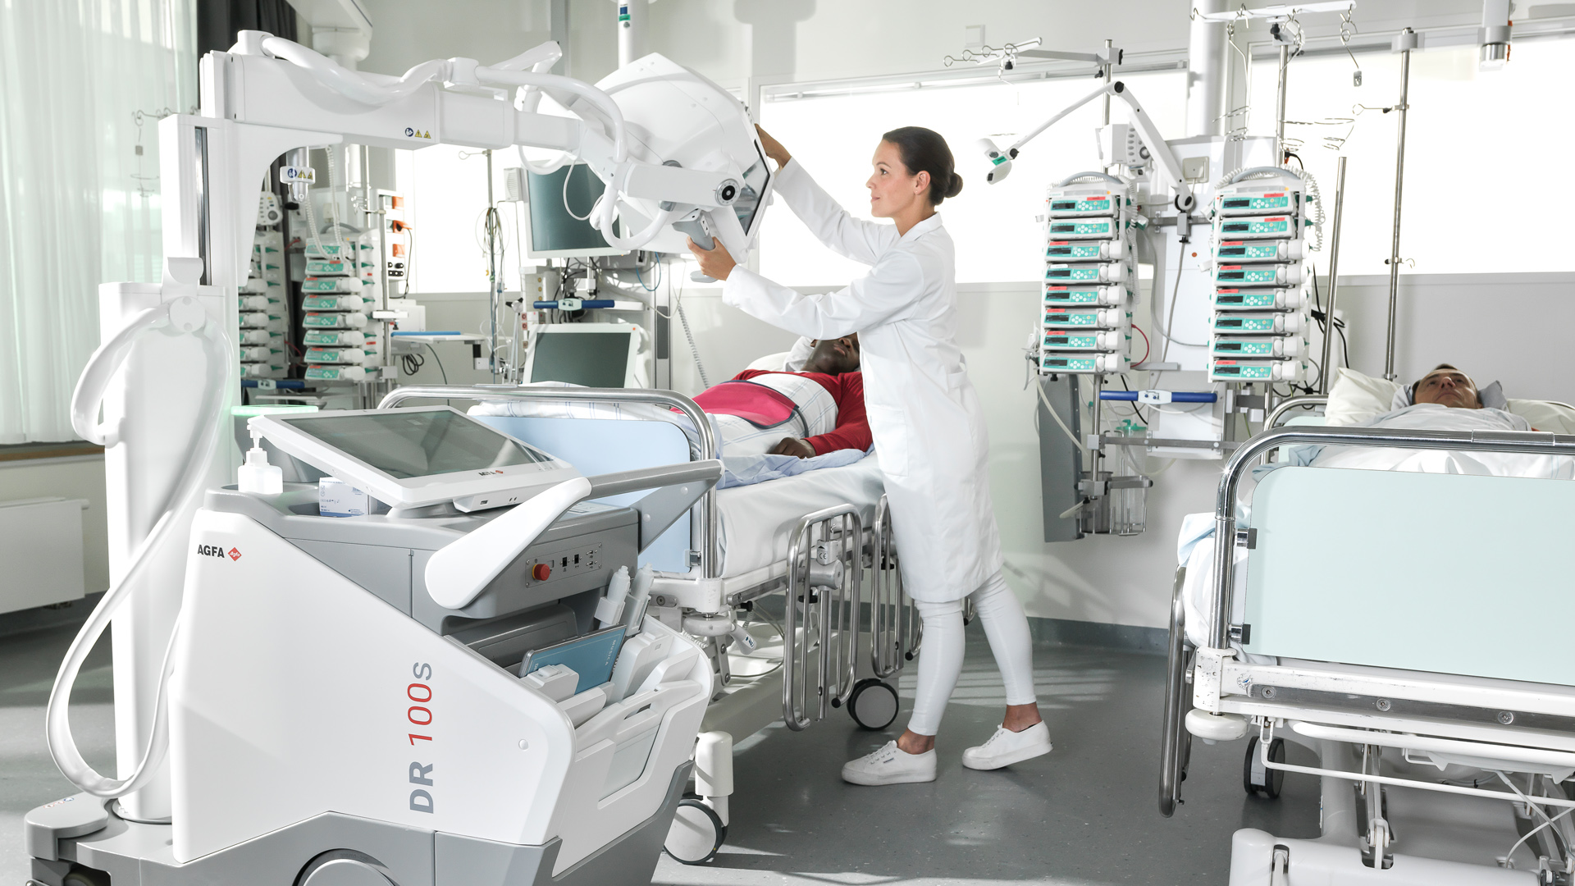
Tube head swiveling in all directions
FreeView telescopic column
10" tube head display for bedside adjustments
22” touch monitor for better image preview
ergonomic power plug
Storage bin:
Anti-theft locking for detectors and remote control
Bluetooth remote exposure switch
Integrated battery charger

Slide 5
Tube head positioning in all directions
Easy & flexible swiveling of tube head in all 3 axes for precision positioning (ZeroForce)
Excellent freedom of positioning
Collimator rotation can be done while swiveling the tube head
Outstanding patient and operator comfort
Watch the video

Slide 6
10" display for bedside adjustments
10-inch tube head display, for bedside adjustments from the tube head
Convenient access to information on patient data and generator settings
Excellent image preview, images can be verified right away to be sure no retakes are required
Tube/detector alignment tool
Watch the video

Slide 7
22” touch monitor for image preview
The monitor’s viewing angle can be adjusted as necessary, to eliminate glare and light reflection
The DR 100s comes standard with the MUSICA Workstation
Broad range of features and tools available
touch-enabled intuitive interface
fast previews
vast number of exam presets

Slide 8
MUSICA Nerve Center
Automatically adds exposure parameters used to the digital image file
Communicates data seamlessly with RIS/HIS and PACS
Modality workflow data entry reduces risk of typographical errors
WIFI access at the patient bedside
increased exam efficiency
faster access to images for diagnosis and clinical review.

Slide 9
Excellent ergonomics
Measures only 58cm/22,8 inch wide
Power plug positioned at a convenient 75 cm above the floor
Height adjustable driving handle
Storage for sanitizer wraps, gloves and hand sanitizer integrated into the cover
Light weight unit

Slide 10
FreeView telescopic column
Increased visibility on the go
Excellent maneuverability
Safe passage in busy corridors, elevators and doors
Easy to drive, position and park
Watch the video

Slide 11
The devil is in the details
Locking mechanism for both detectors and remote control
DR Detector Care Program protects your portable detector from accidental liquid or drop damages
Integrated detector battery charger
Bluetooth remote exposure switch
Watch the video

Slide 12
DR 100s solutions
Maneuverability of mobile unit
ZeroForce technology
Agile movements
Measures only 58cm/22,8 inch wide
Height adjustable driving handle
Good balance
Maneuverability of tube head at bedside
ZeroForce technology
Flexible swiveling of tube head in all 3 axes
Bed-end system positioning possible
Detector protection
Anti theft mechanism locks both detectors and remote control
DR Detector Care Program protects your portable detector from accidental liquid or drop damages
Patient and staff safety
MUSICA Nerve Center
Reduce and manage dose
Avoid retakes
Bluetooth remote exposure switch
X-ray alignement at bedside
Easy and flexible swiveling of tube head in all 3 axes
Collimator rotation can be done while swiveling the tube head
System ergonomics
The monitor’s viewing angle adjustable as necessary
eliminates glare and light reflection
Power plug positioned at a convenient 75 cm above the floor
Storage for sanitizer wraps, gloves and hand sanitizer integrated into the cover
Limited applications with mobile unit
Long length (stitching) exams possible
Standard MUSICA Workstation
Broad range of features and tools available
touch-enabled intuitive interface
fast previews
vast number of exam presets

Slide 13
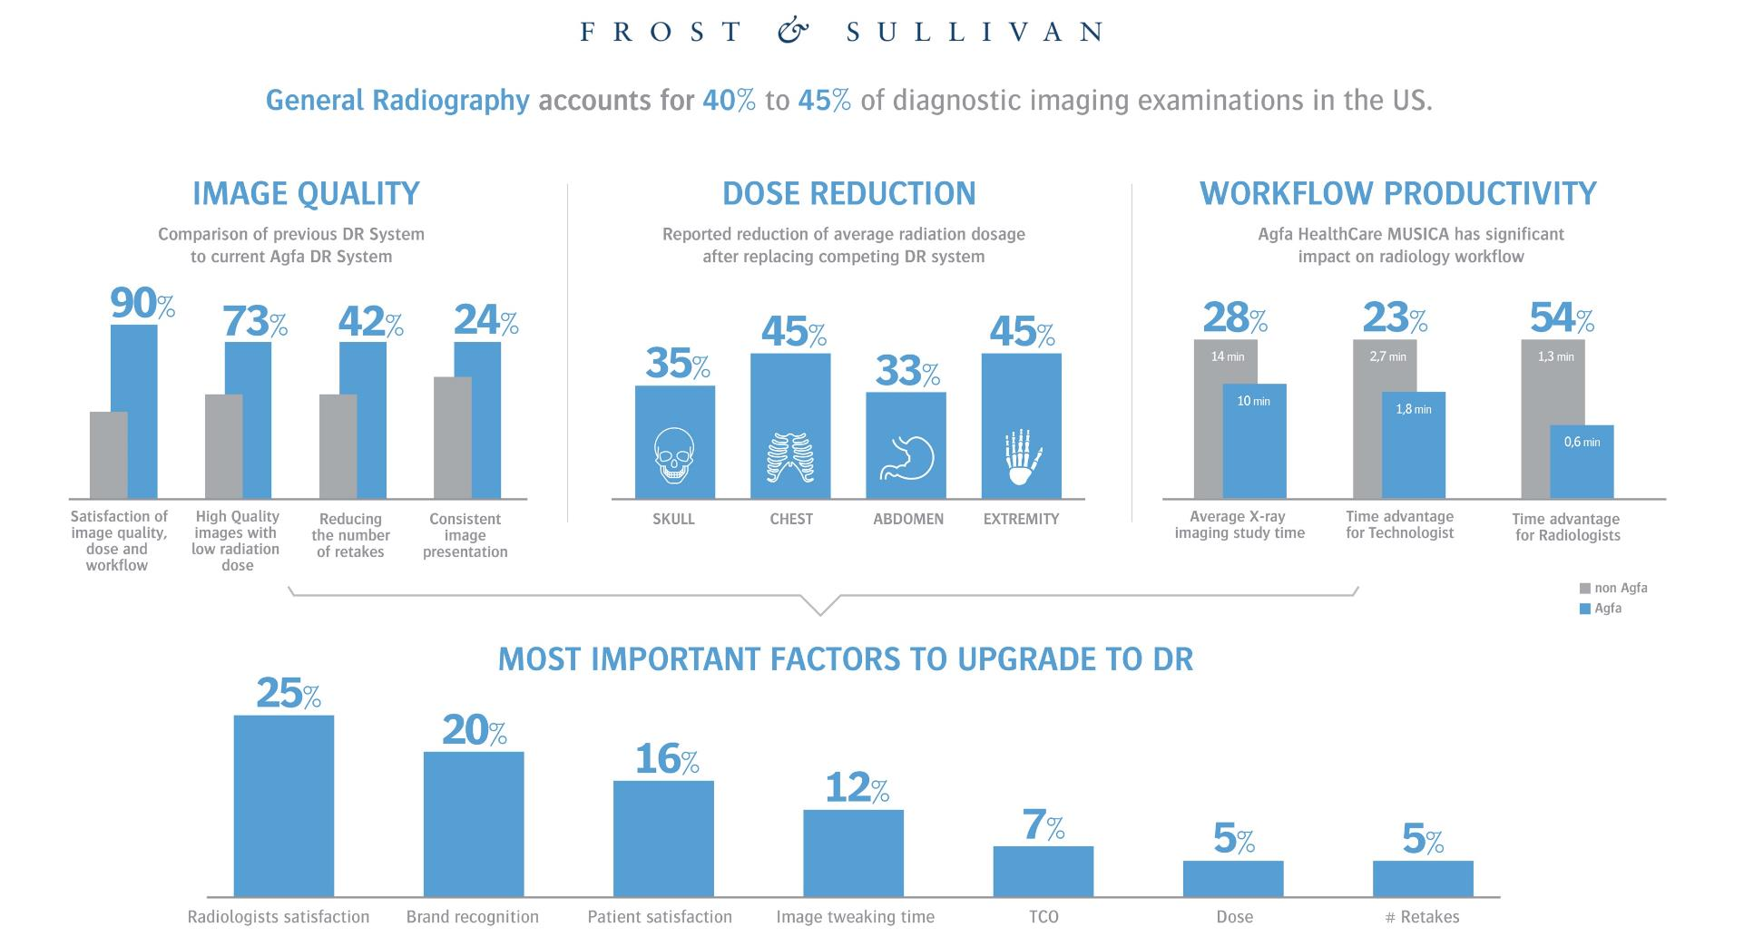
DR: Raising the bar by lowering the dose

Slide 14
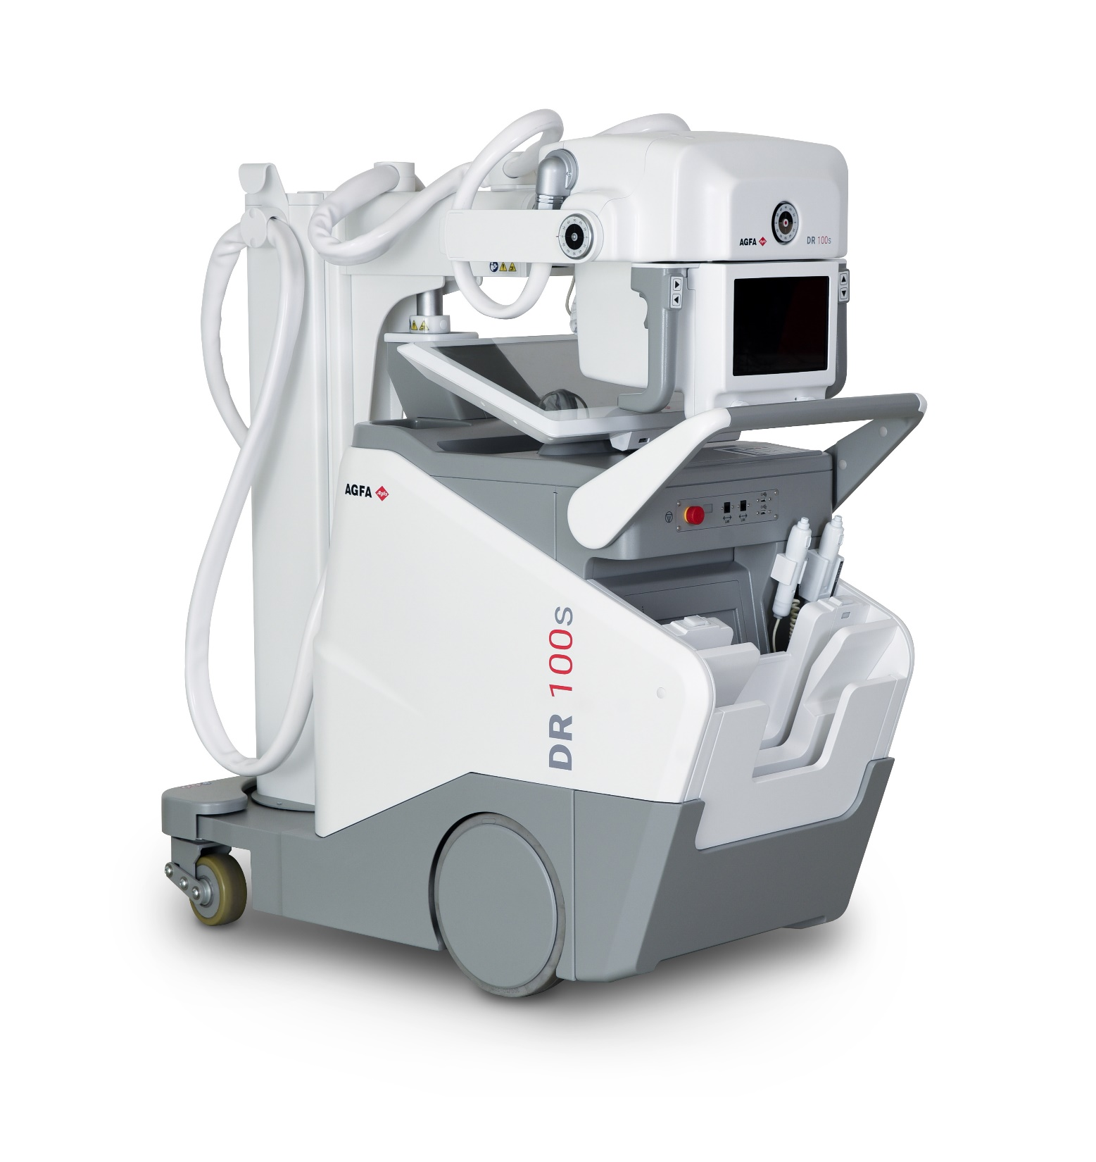
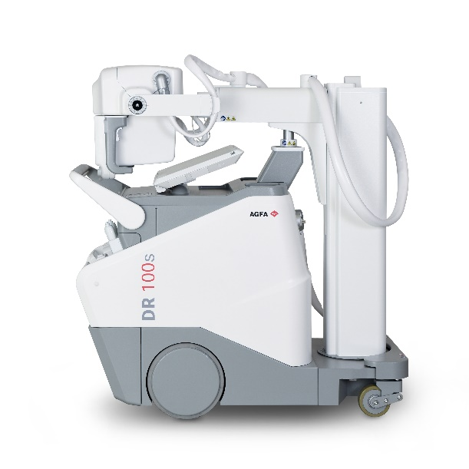
DR 100s
A new Force in mobile imaging

